Slide 1
Hepatitis C
Nikoloz Chkhartishvili, MD, MS, PhD
Deputy Director for Research
Infectious Diseases, AIDS and Clinical Immunology Research Center
@nikoloch
Share your thoughts on this presentation with #IAS2019

Slide 2
Disclosure
No conflicts of interest to declare

Slide 3
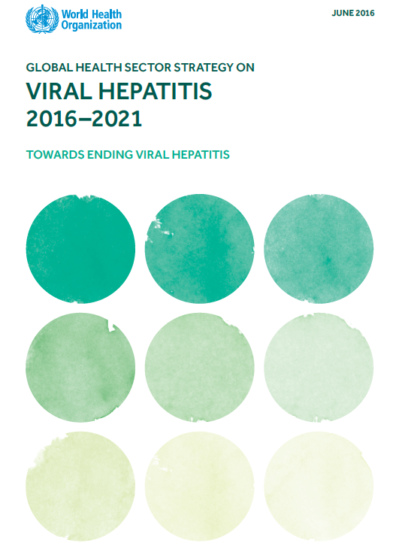
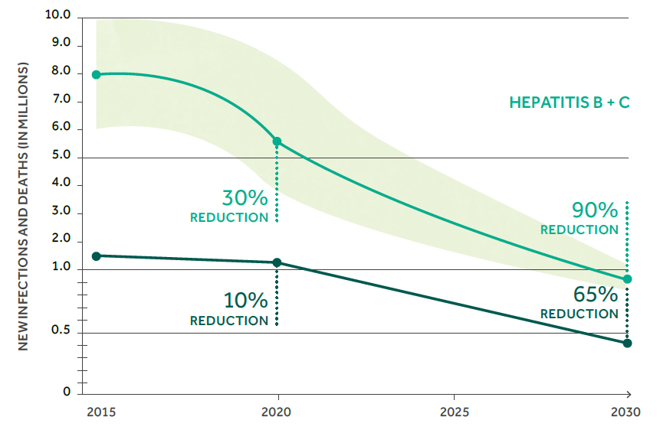
Eliminate Viral Hepatitis as a Major Public Health Threat by 2030
Diagnose 90% of people with chronic hepatitis C
Treat 80% of people with chronic hepatitis C

Slide 4
Global Progress in Hepatitis C Elimination
12 countries on track
to meet elimination targets
Australia - Japan
Egypt - Mongolia
France - Netherlands
Georgia - Spain
Iceland - Switzerland
Italy - UK
Of 45 high-income countries 67% were off-track by at least 20 years
Razavi et al.. EASL 2019. SAT-260; The CDA Foundation. Polaris Observatory. http://cdafound.org/polaris/

Slide 5
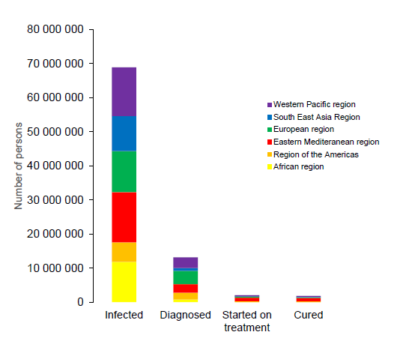
Global HCV Care Cascade
Millions of people living with chronic hepatitis C need to be diagnosed and linked to care
Gap in diagnosis and linkage may lead to “diagnostic burnout”
Bulterys M. EASL 2019

Slide 6
Hepatitis C Treatment Uptake in Georgia
56,318 persons treated with DAAs in Apr 2015 – Apr 2019 (38% of all with chronic HCV infection)
Modeling study suggests:
Treating 4000/month will achieve elimination by 2020
Treating 1000/month will achieve elimination by 2025
Georgia’s HCV Elimination Program Treatment Database. Walker J et al. J Hepatol 2018; 68(Suppl 1): S142.

Slide 7
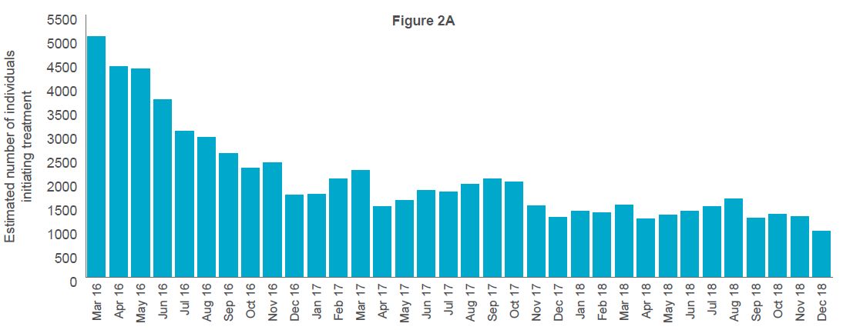
Hepatitis C Treatment Uptake in Australia
Estimated 74,600 persons treated with DAAs in 2014-2018 (33% of all with chronic HCV infection)
Prescriptions by general practitioners increased from 8% in 2016 to 39% in 2018
The Kirby Institute. Monitoring hepatitis C treatment uptake in Australia (Issue 10). June 2019

Slide 8
Hepatitis C Screening Campaign in Egypt
The national HCV treatment program with DAAs began in 2014, and by September 2018, about 2.5 million patients started treatment
By mid 2018, the rate of patients registering for evaluation and treatment markedly decreased
A national population screening program was initiated in October 2018 aiming at screening 52 million adults
In the first 4.5 months of the program, 29.8 million persons were screened
1.2 million were seropositive (4%) and were referred for further evaluation, of whom 75% were viremic.
Esmat G et al. Lancet Gastroenterol Hepatol. 2018;3:665. Abdel-Razek et al. EASL 2019. Abstract LBP-08.

Slide 9
Hepatitis C Care Cascade in Iceland
Number of persons
93%
97%
98%
90%
Olafsson S, et al. J Hepatol. 2019;70(Suppl):e337- 338.

Slide 10
Breaking down national elimination goals into smaller goals for individual population segments, for which treatment and prevention interventions can be delivered more quickly and efficiently using targeted methods
Pursuing the micro-elimination of HCV means working to achieve the WHO targets in specific sub-populations (e.g., people living with HIV, prisoners, people with haemophilia, children), settings (hospitals, addiction centres), generational cohorts (baby-boomers) or geographic areas (a city or region)
Lazarus et al. J Hepatol. 2017;67:665-666

Slide 11
Real-Life SVR Rates in HIV/HCV Co-infection
 |  | SVR (95% CI)
Patel et al, OFID 2017 |  | 93.0% (88.1%-96.3%)
Bhattacharya et al, CID 2017 |  | 90.9% (88.9%-92.7%)
Montes et al, AIDS 2017 |  | 94.0% (91.7%-96.0%)
Bischoff et al, HIV Med 2018 |  | 91.2% (88.3%-93.6%)
Kim et al, OFID 2019 |  | 96.5% (94.5%-97.9%)
Berenguer et al, OFID 2019 |  | 91.8% (87.4%-95.1%)

Slide 12
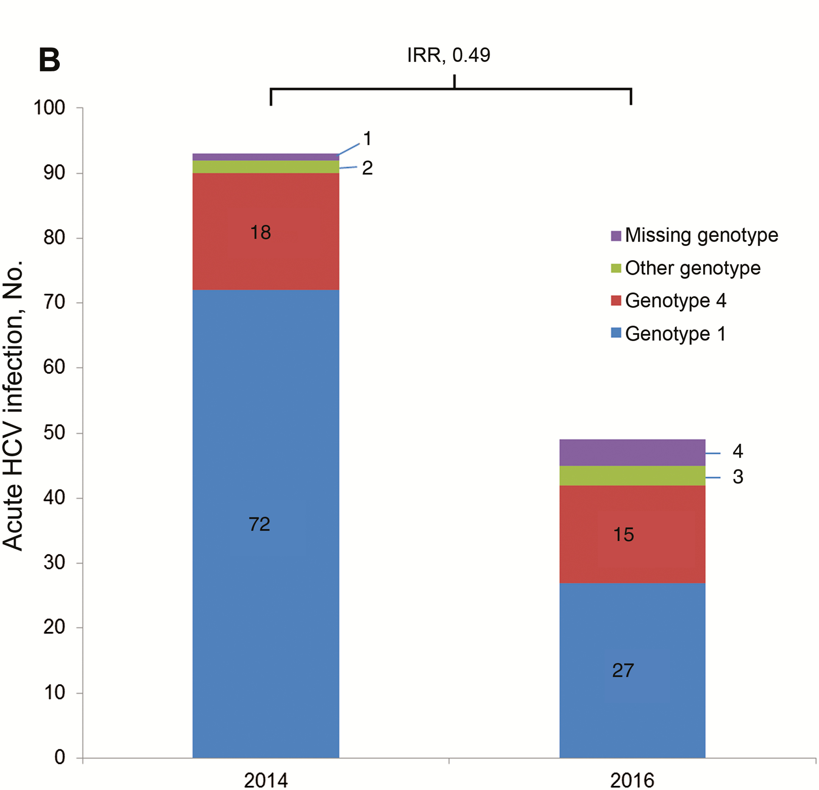
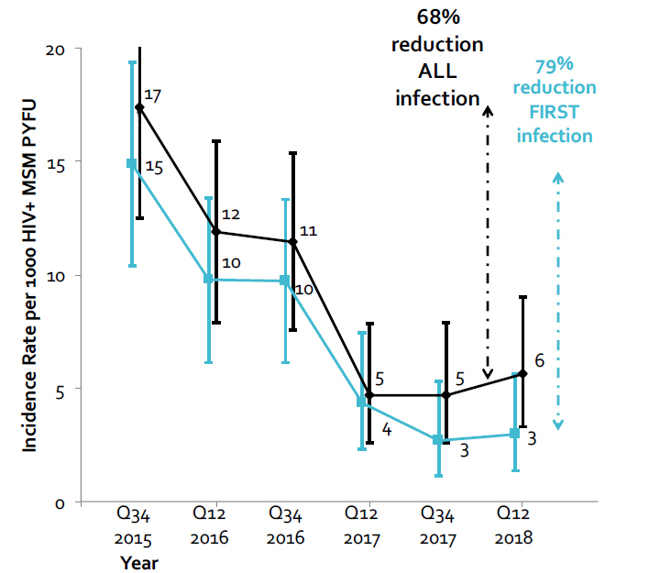
Declining HCV Incidence in HIV+ MSM Through Expanded Access to DAAs: European Experience
Switzerland: 49% decrease Netherlands: 51% decrease London, UK: 68% decrease
Braun D et al. CROI 2018. Abstract 81LB
Boerekamps et al. CID. 2018;66:1360-5.
Garvey et al. CROI 2019. Abstract 85.

Slide 13
Declining HCV Incidence in HIV+ MSM Through Expanded Access to DAAs: Australian Experience
Nurse-led, clinician-directed trial of DAA treatment among people with HCV/HIV co-infection
6 primary and tertiary care sites
Per protocol SVR: 97% in primary care, 100% in tertiary care
HCV RNA prevalence declined from 57% in 2016 to 8% in 2018
21% annual reduction in incidence
Doyle et al. EASL 2019. Abstract THU-395.

Slide 14
HCV Re-infection in HIV+ MSM
Re-infection rate of 7.3/100 PY reported in PROBE-C study in pre-DAA era (2002-2014)
NYC Cohort, USA
Lyon Acute Hepatitis Study, France
p=0.05
p=0.30
HCV re-infection rate: 4.4/100 PY – >7 times the primary infection rate in NYC
Ingiliz P et al. J Hepatol 2017. Carollo et al. CROI 2019. Abstract 086. Ramiere C, et al. Clin Infect Dis 2019.

Slide 15
Contribution of Acute Hepatitis C (AHC) to Ongoing HCV Epidemic in HIV+ MSM
Outcomes of 464 AHC episodes without immediate treatment
Treatment uptake within 6 months for acute hepatitis diagnoses, 2007-2017
Only 11.9% spontaneously cleared HCV
SVR: 75.6% (245/324); Re-infections: 17% (50/300)
Spontaneous clearance was associated with >2 log drop in HCV RNA at week 4
87% (241/277) of AHC patients treated with IFN
17% (8/47) of AHC patients treated with DAAs
Treatment uptake dropped from 75% in 2007 to 14% in 2017
The delay in HCV treatment initiation increases the risk for further HCV transmissions
Preventing transmissions through early treatment can contribute to achieving micro-elimination
Boesecke et al. CROI 2018, Abstract 129. Boesecke et al. CROI 2019, Abstract 576.

Slide 16
Removing the transmission risk associated with injection drug use could prevent 43% of incident HCV infections globally from 2018 to 2030

Slide 17
HCV Treatment Among PWID
SVR12 in clinical trials and real-world cohorts of PWID:
91.5% (Dore et al. Ann Intern Med 2016); 94%(Grebely et al. Lancet Gastroenterol Hepatol 2018); 90% (Alimohammadi et al. OFID 2018)
Meta-analysis of treatment efficacy (Latham et al. Liver Int 2019)
Pooled SVR for recent PWID: 88%
Pooled SVR for OST recipients: 91%
Increasing treatment uptake in Australia (Iversen et al. J Hepatol 2019)
Treatment initiation increased form 10% in 2015 to 41% in 2017
HCV viremic prevalence decreased from 43% in 2015 to 25% in 2017

Slide 18
HCV Re-Infection Among PWID

Slide 19
HCV Elimination in HIV+ PWID
HCV treatment targeted at HIV-infected PWID would not achieve elimination among this population due to continued risk of HCV transmission from HIV-negative PWID populations
As HIV-infected PWID populations are likely to mix with HIV-uninfected PWID populations, elimination among HIV-infected PWID is probably only achievable if combination HCV prevention efforts are targeted both HIV+ and HIV- PWID populations
Martin et al. J Int AIDS Soc 2018, 21(S2):e25062

Slide 20
Coverage of Harm Reduction Services
 | Needle-syringes per PWID per Year | OST clients per 100 Primary Opioid Injectors
Eastern Europe | 15 (9-27) | 1 (1-3)
Western Europe | 166 (118-243) | 94 (67-100)
East and Southeast Asia | 16 (13–21) | 9 (7–11)
South Asia | 43 (35–56) | 91 (73–100)
Central Asia | 115 (78–172) | 1 (1–2)
Caribbean | 6 (4–8) | 11 (7–18)
Latin America | 6 (5–8) | 3 (3–5)
North America | 39 (22–66) | 27 (16–61)
Australasia | 396 (309–550) | 73 (56-100)
Middle East and North Africa | 2 (1–4) | 6 (4–11)
Sub-Saharan Africa | 2 (<1–4) | 1 (<1–4)
Global | 33 (21-50) | 19 (13-21)
Lamey et al. Lancet Glob Health 2017; 5: e1208–20

Slide 21
Summary
HCV micro-elimination is achievable only through delivering comprehensive response
Political commitment and major investments
Affordable diagnostics and treatment
Regular HCV testing and unrestricted access to DAAs
Early treatment of acute hepatitis C
Harm reduction and behavioral interventions

Slide 22
WEAB03 Deadly partners: HIV and co-infections
WEAB0303 HCV reinfection among HIV/HCV co-infected individuals in Europe
Sarah Amele, UCL, United Kingdom
Wednesday 24 July, 16:30 - 18:00

